Slide 1


Samantha Maraj
August 29th 2022

Slide 2


Outline
Executive Summary
Introduction
Methodology
Results
Conclusion
Appendix

Slide 3
Summary of methodologies
Data collection methodologies used included RESTful API and web scraping. Exploratory data analysis was done using SQL, data visualisation using Matplotlib and Pandas, Folium and Plotly. Prediction was done using Machine Learning.
Summary of all results
Exploratory data analysis results, visualisation and predictive results follow.
Executive Summary

Slide 4
Introduction
Project background and context
SpaceX advertises Falcon 9 rocket launches on its website, with a cost of 62 million dollars; other providers cost upward of 165 million dollars each, much of the savings is because SpaceX can reuse the first stage. We seek to predict if the Falcon 9 first stage will land successfully. S Therefore if we can determine if the first stage will land, we can determine the actual cost of a launch. This information can be used if an alternate company wants to bid against SpaceX for a rocket launch.
Problems to find answers to
The total cost of launches by determining whether the first stage will land successfully and
What factors determine/influence successful landings.

Slide 5

Section 1

Slide 6
Methodology
Executive Summary
Data collection methodology:
RESTful API and web-scraping
Perform data wrangling
One hot encoding and data cleaning
Perform exploratory data analysis (EDA) using visualization and SQL
Perform interactive visual analytics using Folium and Plotly Dash
Perform predictive analysis using classification models
Data normalized, divided in training and test data sets and evaluated by four different classification models, the accuracy of each model evaluated

Slide 7
Data Collection
SpaceX Launch Data was collected using the publicly available SpaceX Rest API
Data was also collected using web-scraping from Wikipedia

Slide 8
Data Collection – SpaceX API
The SpaceX Rest API was used to extract data about past launches.
A 'get' request was used. Our response was in the form of a Json. The Json was then converted to a dataframe, and filtered and cleaned.
The GitHub URL of the completed SpaceX API calls notebook is https://github.com/Sammers89/CapstoneProject/blob/ca18e72bee180cb09bf087364f8af13fa6997905/Collecting%20the%20Data.ipynb
Get request for rocket launch data using SpaceX API and SpaceX URL
Convert response to JSON file
Convert JSON file to Dataframe
Filter and clean dataframe and handle missing values
Export to final CSV file

Slide 9
Data Collection - Scraping
Webscraping some HTML tables from Wikipedia was also done using BeautifulSoup.
This data was parsed and converted to a Pandas database for further visualization and analysis.
The GitHub URL of the completed webscraping notebook is https://github.com/Sammers89/CapstoneProject/blob/ca18e72bee180cb09bf087364f8af13fa6997905/Data%20Collection%20with%20Web%20Scraping.ipynb
The HTTP Get method was applied using the specific Wikipedia URL
Convert HTML response to a BeautifulSoups Object
Column names were extracted using the HTML table header
The HTML data was parsed, and a dictionary and dataframe was created.

Slide 10
Data Wrangling
We performed some Exploratory Data Analysis (EDA) to find some patterns in the data and determined what would be the label for training supervised models.
We calculated the number of launces at each site, the number and occurrence of each orbit, the number and occurrence of each mission outcome, and created a simplified landing outcome label from the outcome column.
The GitHub URL of the completed data wrangling notebook is https://github.com/Sammers89/CapstoneProject/blob/ca18e72bee180cb09bf087364f8af13fa6997905/EDA.ipynb
Exploratory Data Analysis
Summarizations
Creation of landing outcome label from Outcome column

Slide 11
EDA with Data Visualization
Multiple scatterplots were plotted to visualize the relationship between Payload Mass v Flight Number, Flight Number v Launch Site, Payload v Launch Site, Flight Number v Orbit Type and Payload v Orbit Type.
A bar chart was plotted to visualize the success rate of each orbit.
A line chart was plotted to depict the launch success yearly trend.
The GitHub URL of the completed EDA with Data Visualization notebook is https://github.com/Sammers89/CapstoneProject/blob/b91546bd3f953168a4718069d20ee2584830f47c/EDA%20with%20Visualization.ipynb

Slide 12
EDA with SQL
• The following SQL queries were performed:
Names of the unique launch sites
Top 5 launch sites whose name begin with the string 'CCA’
Total payload mass carried by boosters launched by NASA(CRS)
Average payload mass carried by booster version F9 v1.1
Date when the first successful landing outcome in ground pad was achieved
Names of the boosters which have success in drone ship and have payload mass between 4000 and 6000 kg
Total number of successful and failure mission outcomes
Names of the booster versions which have carried the maximum payload mass
Failed landing outcomes in drone ship, their booster versions, and launch site names for in year 2015
Rank of the count of landing outcomes (such as Failure (drone ship) or Success (ground pad)) between the date 2010-06-04 and 2017-03-20.
The GitHub URL of the completed EDA with SQL notebook is https://github.com/Sammers89/CapstoneProject/blob/b91546bd3f953168a4718069d20ee2584830f47c/EDA%20with%20SQL.ipynb

Slide 13
Build an Interactive Map with Folium
We created and added Folium Markers, circles, labels, colored markers and PolyLines to better visualize locations and relative distances on the maps of the launch sites.
We added a MousePosition to the Map to easily get coordinates for points on the map.
The GitHub URL of the completed interactive map with Folium notebook is https://github.com/Sammers89/CapstoneProject/blob/b91546bd3f953168a4718069d20ee2584830f47c/Interactive%20Visual%20Analytics%20with%20Folium.ipynb

Slide 14
Build a Dashboard with Plotly Dash
A dropdown selection, a pie chart, a range slider and a scatter point chart were added to a Plotly Dashboard.
These visualizations allows for quick analysis of the various factors leading to a launch.
The GitHub URL of the completed Plotly Dashboard Lab notebook is https://github.com/Sammers89/CapstoneProject/blob/b2af3310cc13a135cdf36c0e4112cc1ec8bb4886/dash_interactivity.py

Slide 15
Predictive Analysis (Classification)
The data was standardized and split into testing and training data.
Four classification models were used: logistic regression, support vector machine, decision tree and k nearest neighbors.
Confusion matrices were used to analyse the models.
Each model was tested using combinations of parameters. Each model was then scored based on the testing data.
The GitHub URL of the completed interactive map with Folium notebook is https://github.com/Sammers89/CapstoneProject/blob/b91546bd3f953168a4718069d20ee2584830f47c/Machine%20Learning%20Prediction
Data prepared, standardized and split
All four models used and tested with various paramaters
The results of each model were compared.

Slide 16
Exploratory data analysis results and screenshots follow in the next section.
Interactive analytics observations and screenshots follow in the next section.
Predictive analysis results follow in the final section.
Results

Slide 17

Section 2

Slide 18
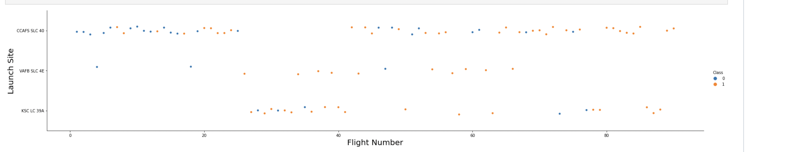
Flight Number vs. Launch Site
Launch site CCAPS SLC 40 was the most successful launch site, and also the site more frequently used.
Success rates have improved with recency.

Slide 19
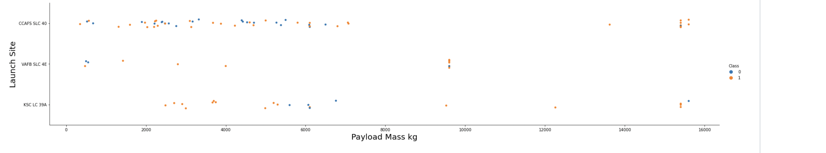
Payload vs. Launch Site
Higher payload masses appear to have a higher success rate
Lower payload masses were more frequently launched from CCAFS SLC 40.
It does not appear that any launches with payload masses exceeding 10000kg were launched from VAFB SLC 4E

Slide 20
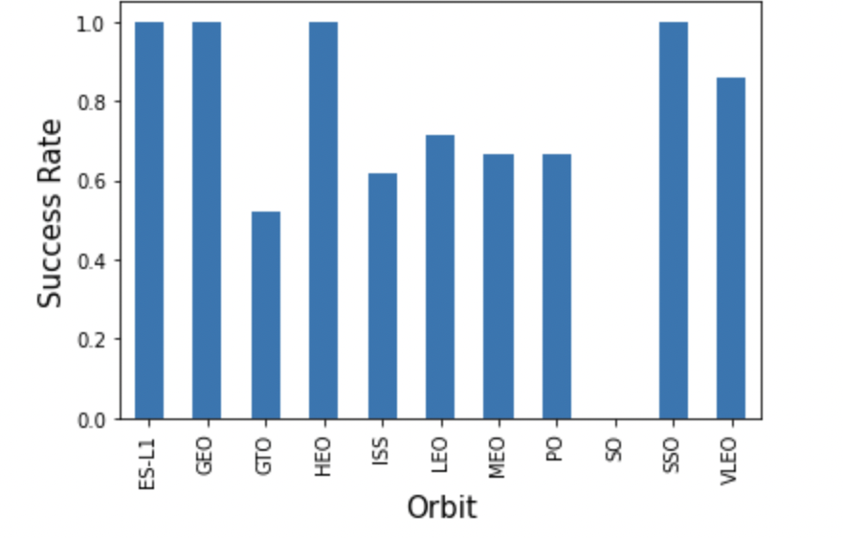
Success Rate vs. Orbit Type
ES-L1, GEO, HEO, and SSO orbits have 100% success rates.
The GTO and SO orbits have the lowest observed success rate.

Slide 21
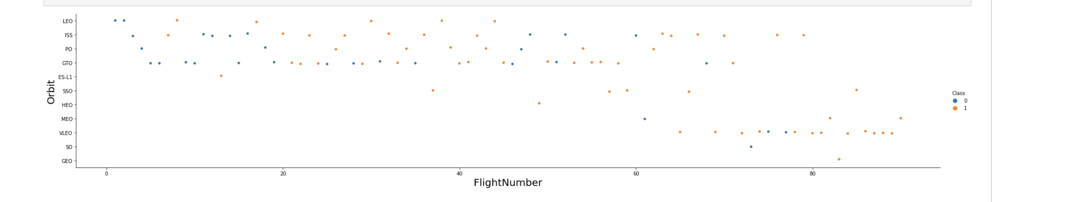
Flight Number vs. Orbit Type
The VLEO orbit type appears to be the most used in recency
Success rates have improved over time for most orbit types.

Slide 22
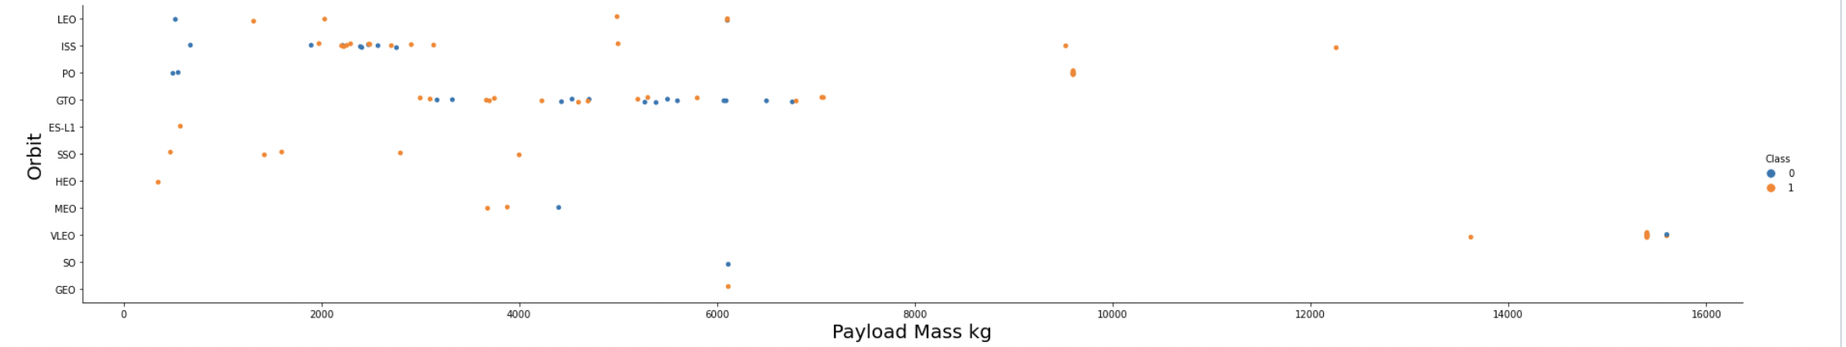
Payload vs. Orbit Type
The SO and GEO orbits were used for few launches
The VLEO seems to have been used for the largest payloads.
The ISS and GTO orbits were more frequently used for payloads between 2000kg and 8000kg.

Slide 23
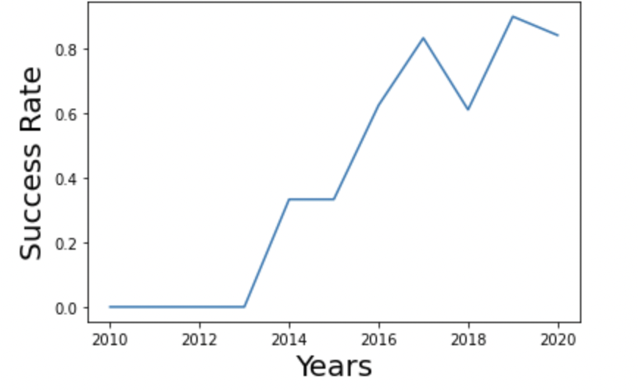
Launch Success Yearly Trend
Launch success rates have generally followed an upward trend over the last 10 years.
Fairly large jumps can be seen (e.g. 2013 to 2014, 2015 to 2017) which may be a reflection of improvements in technology.

Slide 24
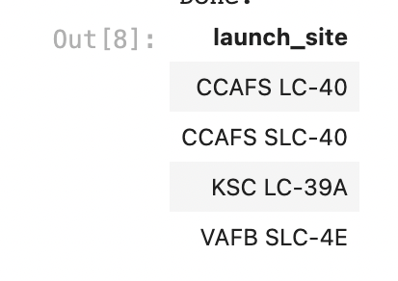
All Launch Site Names
Using the "unique" qualifier, launch site names were queried. There were four unique launch sites as follows:

Slide 25
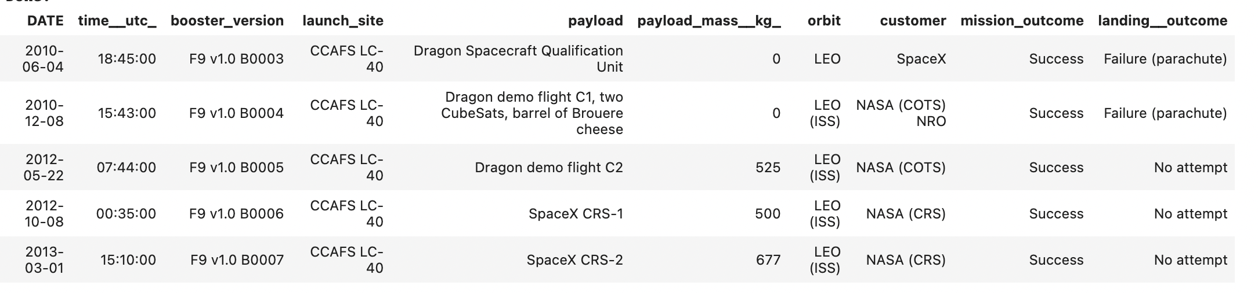
Launch Site Names Begin with 'CCA'
To find 5 records where launch sites begin with `CCA` we used the select where like 'CCA' statement.
The query results follow:

Slide 26
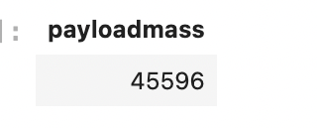
Total Payload Mass
To calculate the total payload carried by boosters from NASA, we used the Select sum where customer = 'NASA (CRS)' statement.
The query results follow:

Slide 27

Average Payload Mass by F9 v1.1
To calculate the average payload mass (assigned to variable payloadmass2) carried by booster version F9 v1.1, we used the select average where booster version is like "F9 v1.1" statement.
The query results follow:

Slide 28

First Successful Ground Landing Date
To find the dates of the first successful landing outcome on ground pad (assigned to variable firstdate), we used the select min date where the landing outcome = Success statement.
The query results follow:

Slide 29
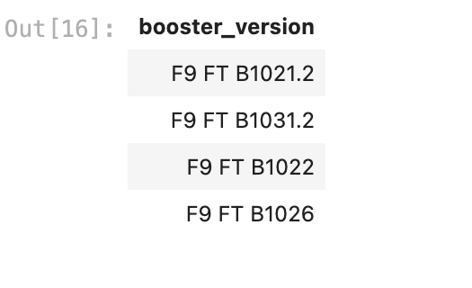
Successful Drone Ship Landing with Payload between 4000 and 6000
To the names of boosters which have successfully landed on drone ship and had payload mass greater than 4000 but less than 6000, we used the select unique where landing outcome = success (drone ship) and payload mass is between 4000kg and 6000kg.
The query results are shown below.

Slide 30
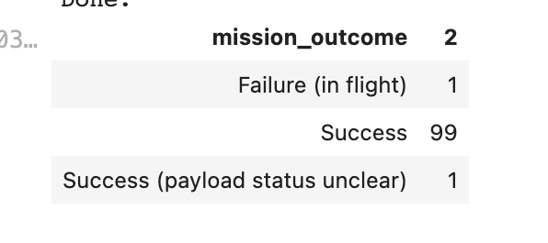
Total Number of Successful and Failure Mission Outcomes
To calculate the total number of successful and failure mission outcomes, we counted the outcomes and then grouped by outcome.
The query results are shown below:

Slide 31
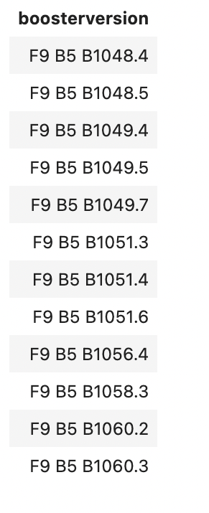
Boosters Carried Maximum Payload
To list the names of the booster which have carried the maximum payload mass, we used a sub query to select the booster versions where the payload mass was max.
The query results are shown to the right.

Slide 32
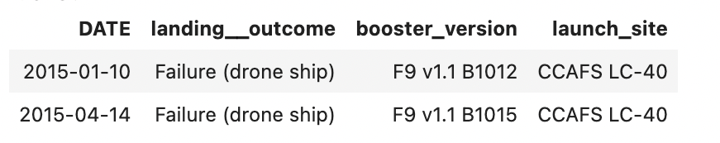
2015 Launch Records
To list the failed landing_outcomes in drone ship, their booster versions, and launch site names for in year 2015 we used a select where statement.
The results are shown below.

Slide 33
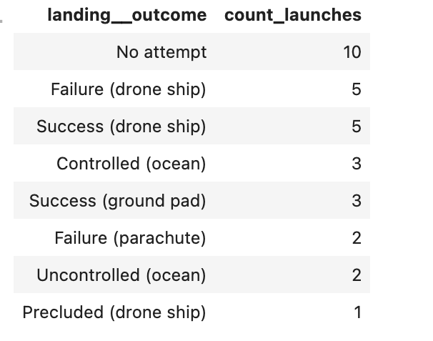
Rank Landing Outcomes Between 2010-06-04 and 2017-03-20
To rank the count of landing outcomes (such as Failure (drone ship) or Success (ground pad)) between the date 2010-06-04 and 2017-03-20, in descending order, we used a select, count where and order by and group by statement.
The query results are shown below.

Slide 34

Section 3

Slide 35
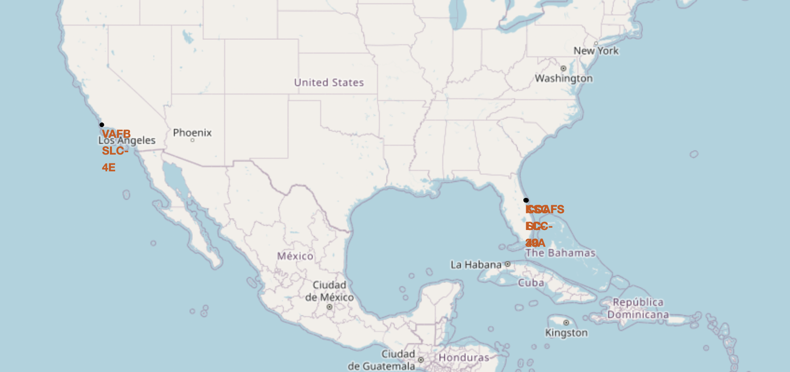
Launch Sites- Location
All launch sites were marked on a map using Folium as below:
It is noted that all launch sites are in coastal areas and near large cities where infrastructure is likely to support launches.

Slide 36
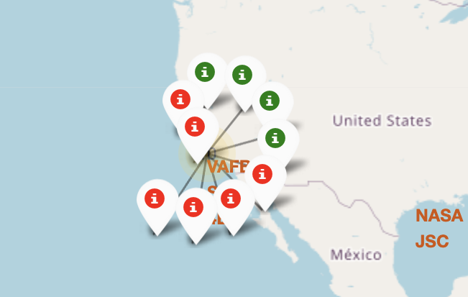
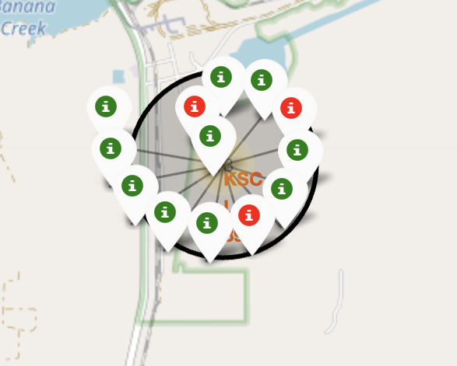
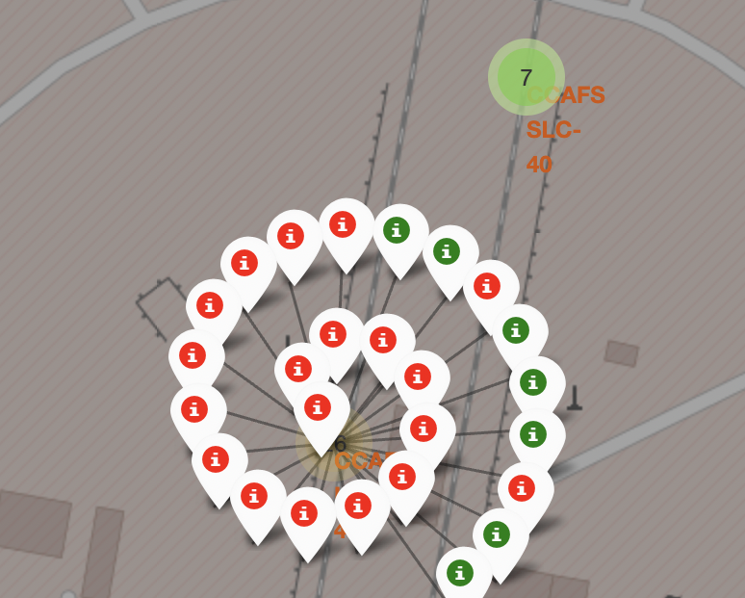
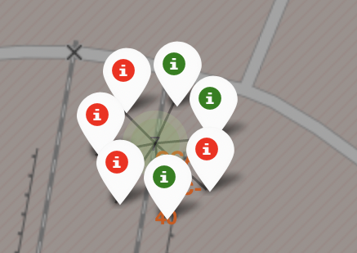
Launch Outcomes by Site
Using marker objects and assigning colours to the markers, we are able to easily identify the number of successes (green) and failures (red) at each site by zooming in on the map. These are shown below for each site.

Slide 37
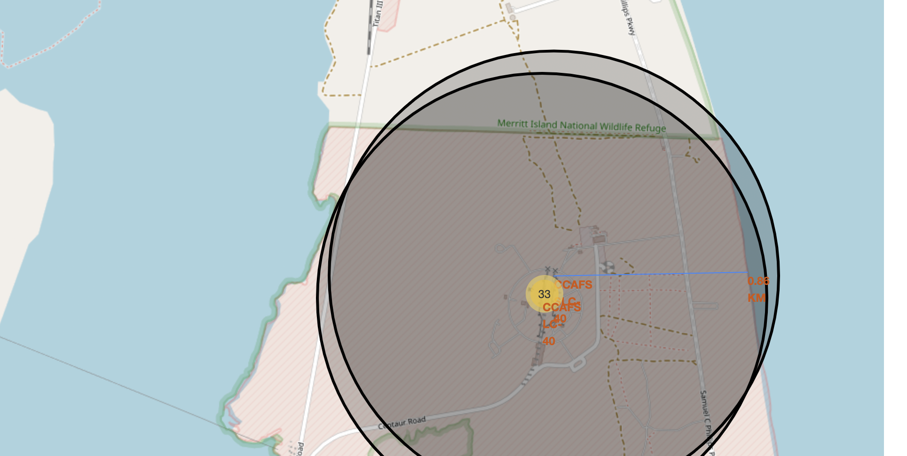
Launch Site Relative Locations
Using Folium maps and Polylines, the location of the launch sites can be plotted and calculated relative to the any location coordinate. In the following screenshot, the location of the launch site is calculated to the coastline.

Slide 38

Section 4

Slide 39
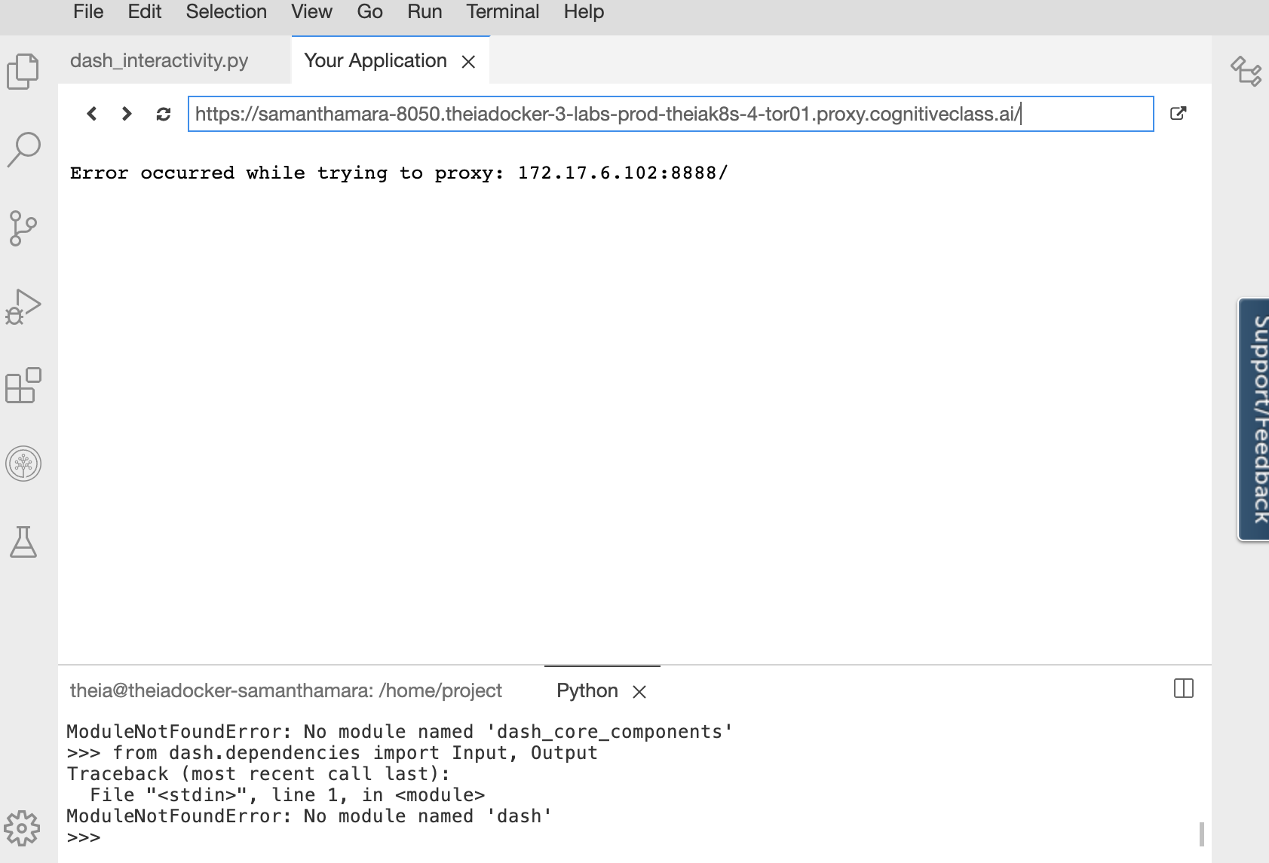
Launch Success by Launch Site
We can note that the site of launch had an impact on the success rate of the launch.
My plotly dashboard was unable to launch despite various reviews of the code by the Coursera Team. As such, screenshots are not included.

Slide 40
Success Rate by Site
The success rate of the selected site would be displayed.
My plotly dashboard was unable to launch despite various reviews of the code by the Coursera Team. As such, screenshots are not included.

Slide 41
Payload Vs Launch Outcome
The Payload vs. Launch Outcome scatter plot for all sites would be displayed with different payload selected in the range slider.
My plotly dashboard was unable to launch despite various reviews of the code by the Coursera Team. As such, screenshots are not included.

Slide 42

Section 5

Slide 43
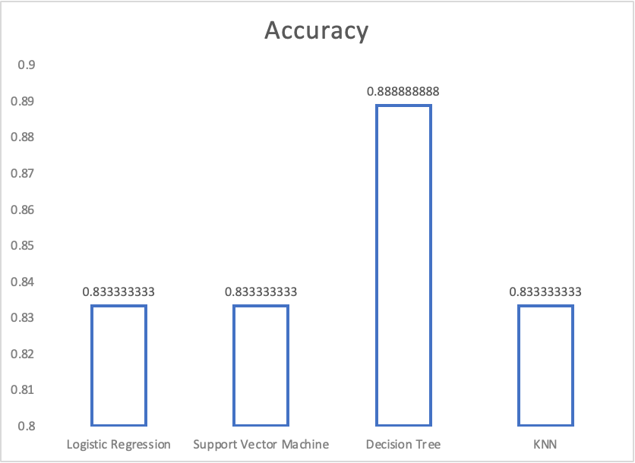
Classification Accuracy
The Decision Tree model had the highest accuracy of all models employed.
It is to be noted that the sample size was very small, and as such the accuracy of each model was very similar.

Slide 44
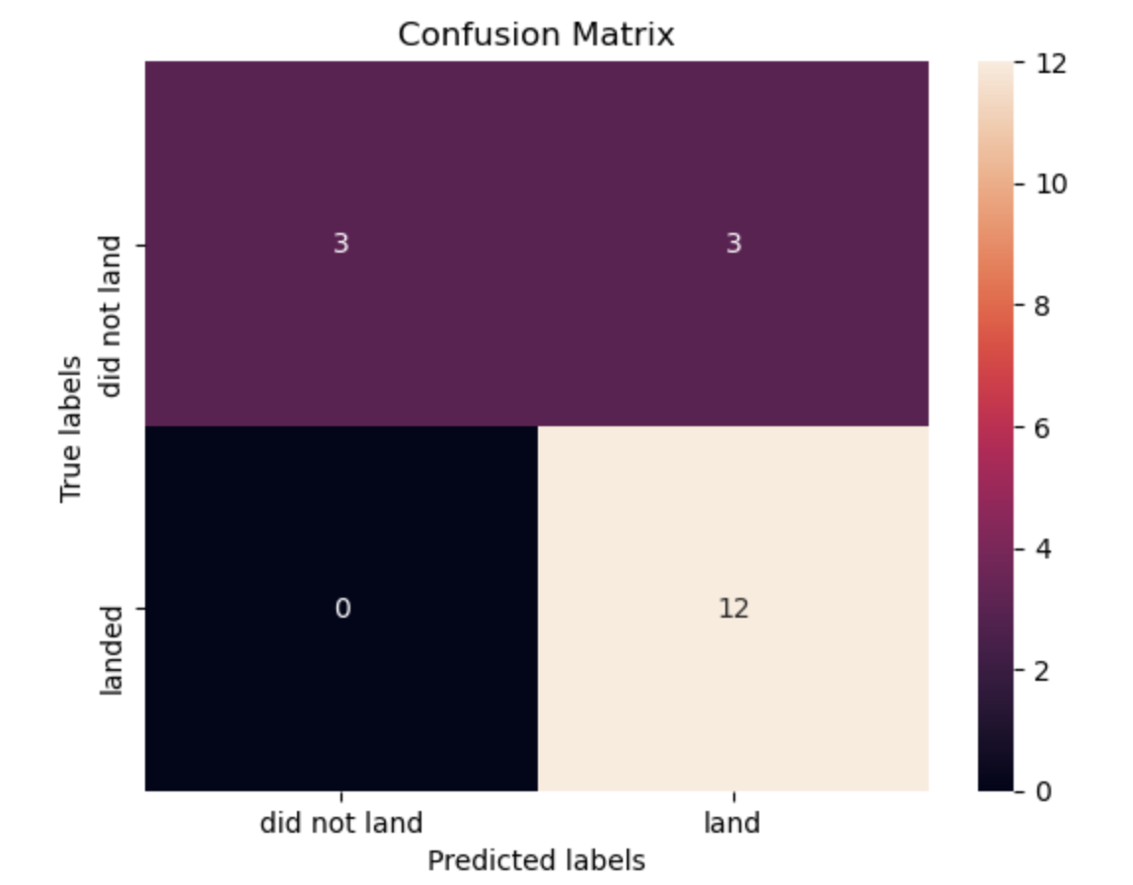
Confusion Matrix
The confusion matrix of the Decision Tree model shows that the model is able to properly classify outcomes. The major problem with the model is the number of false (3 outcomes classified as landed but did not actually land).

Slide 45
Different data sources were analyzed.
Launch success rates have improved over time.
CCAPS SLC 40 and KSC LC 39A have been the most successful launch sites.
Some orbits had higher success rates than others e.g. ES-L1, GEO, HEO, and SSO.
Larger payload masses appear to be more successful.
A decision Tree Classifier was used to predict successful landings with a high success rate and can be employed by another company to increase profits.
Conclusions

Slide 46
Appendix
The link to the GITHUB repository containing all notebooks for this project is https://github.com/Sammers89/CapstoneProject

Slide 47


